Slide 1
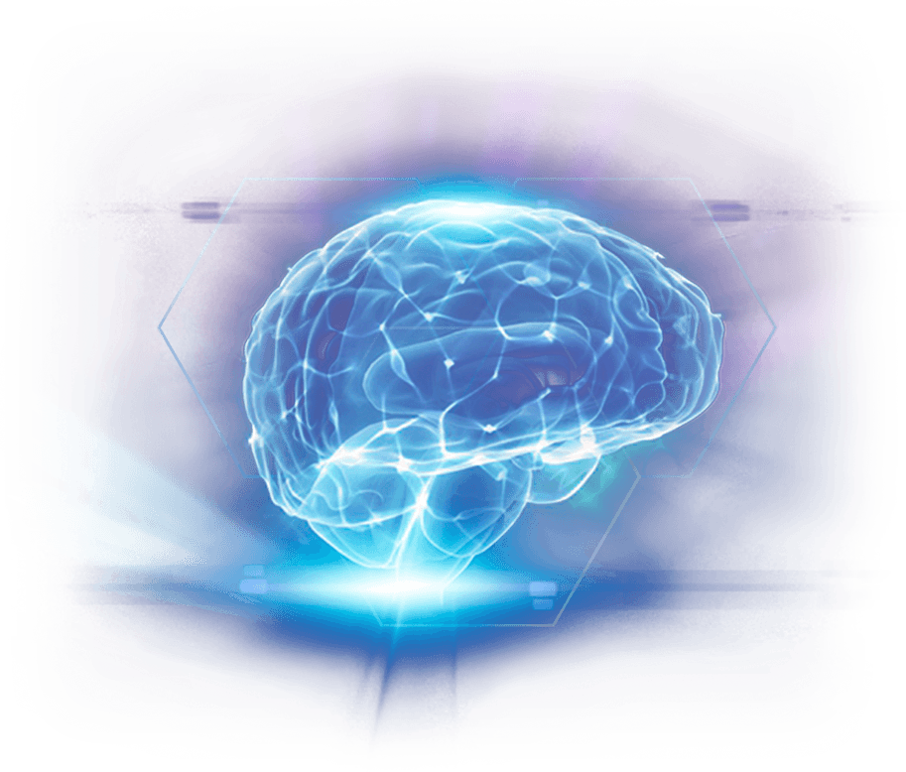
BRAIN TUMOR DETECTION USING
MACHINE LEARNING APPROACH
By Sudesh Pawar
Class : TE-1
PRN : F17111037(24)
Guide Name : Dr. Jayshree R. Pansare
01

Slide 2
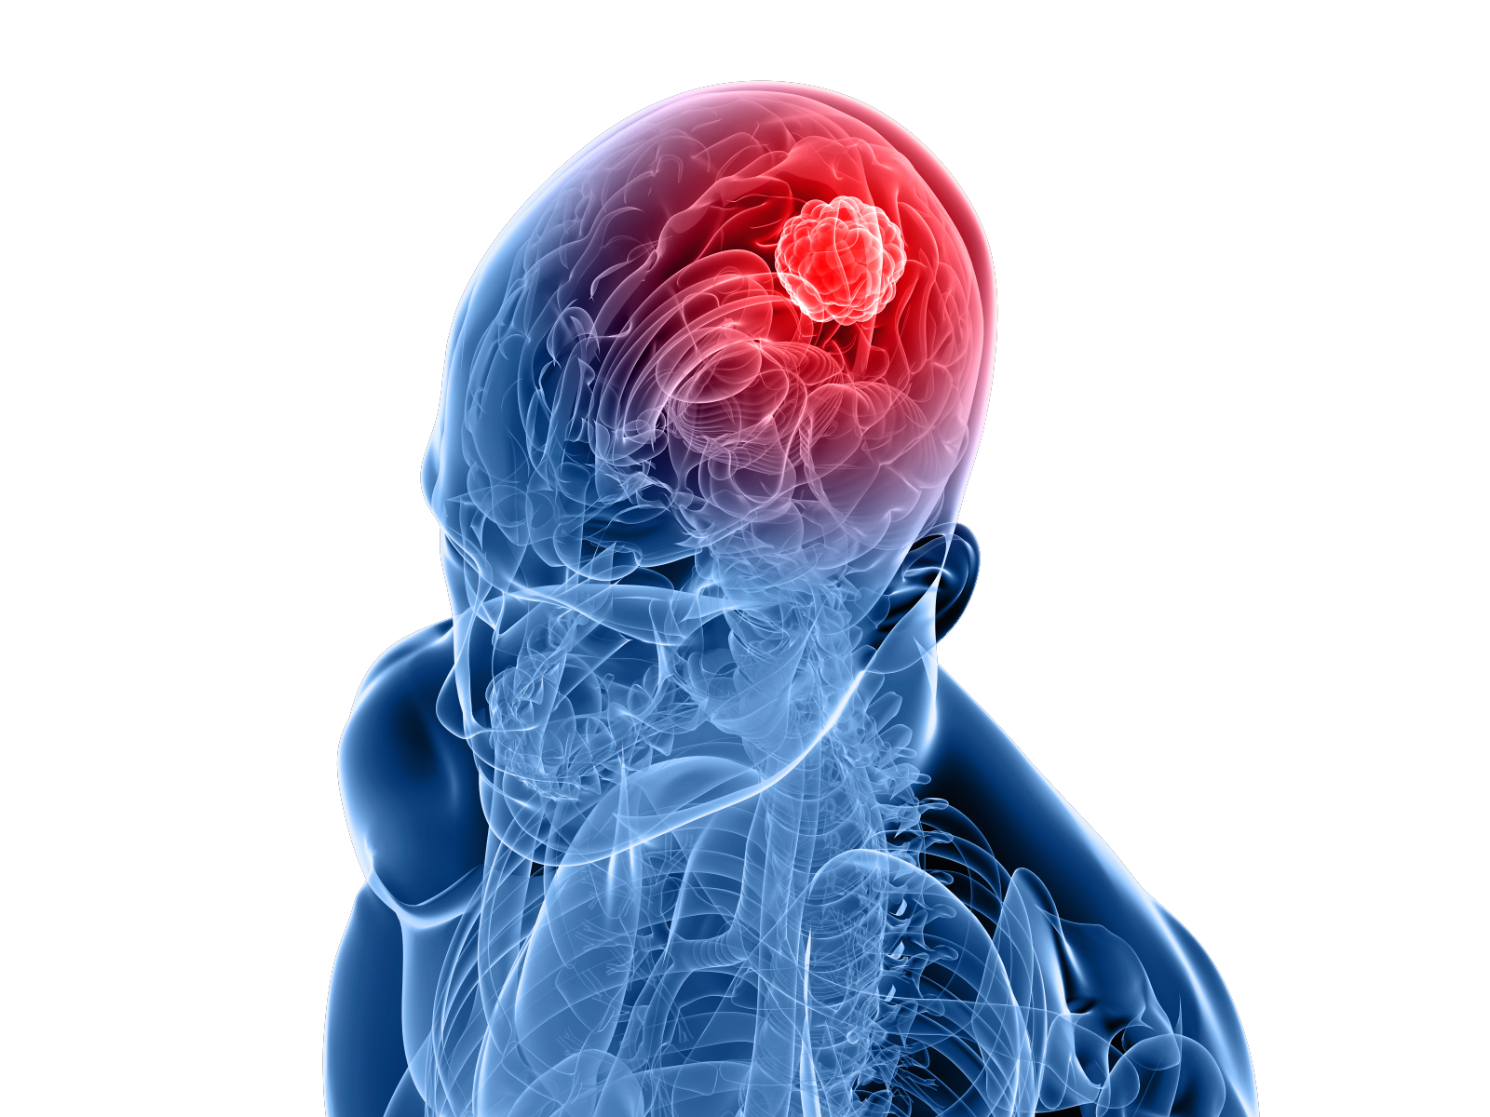
Introduction
Nowadays, Brain Tumor Detection has turned up as a important parameter in the realm of health care. The process of Image Segmentation is adopted for extracting abnormal tumor region. The method proposed assures to be efficient and precise for brain tumor detection, classification and segmentation. To achieve this precise automatic/ semi-automatic methods are needed.
The research proposes an automated segmentation method that relies upon CNN. By incorporating this single technique, segmentation and classification is accomplished. The techniques of ML and Data mining are being effectively employed for brain tumor detection and prevention at an early stage.
Brain tumor can be denoted as a ill-shaped tissue wherein the cells multiply abruptly.
BRAIN TUMOR DETECTION USING MACHINE LEARNING APPROACH
02

Slide 3
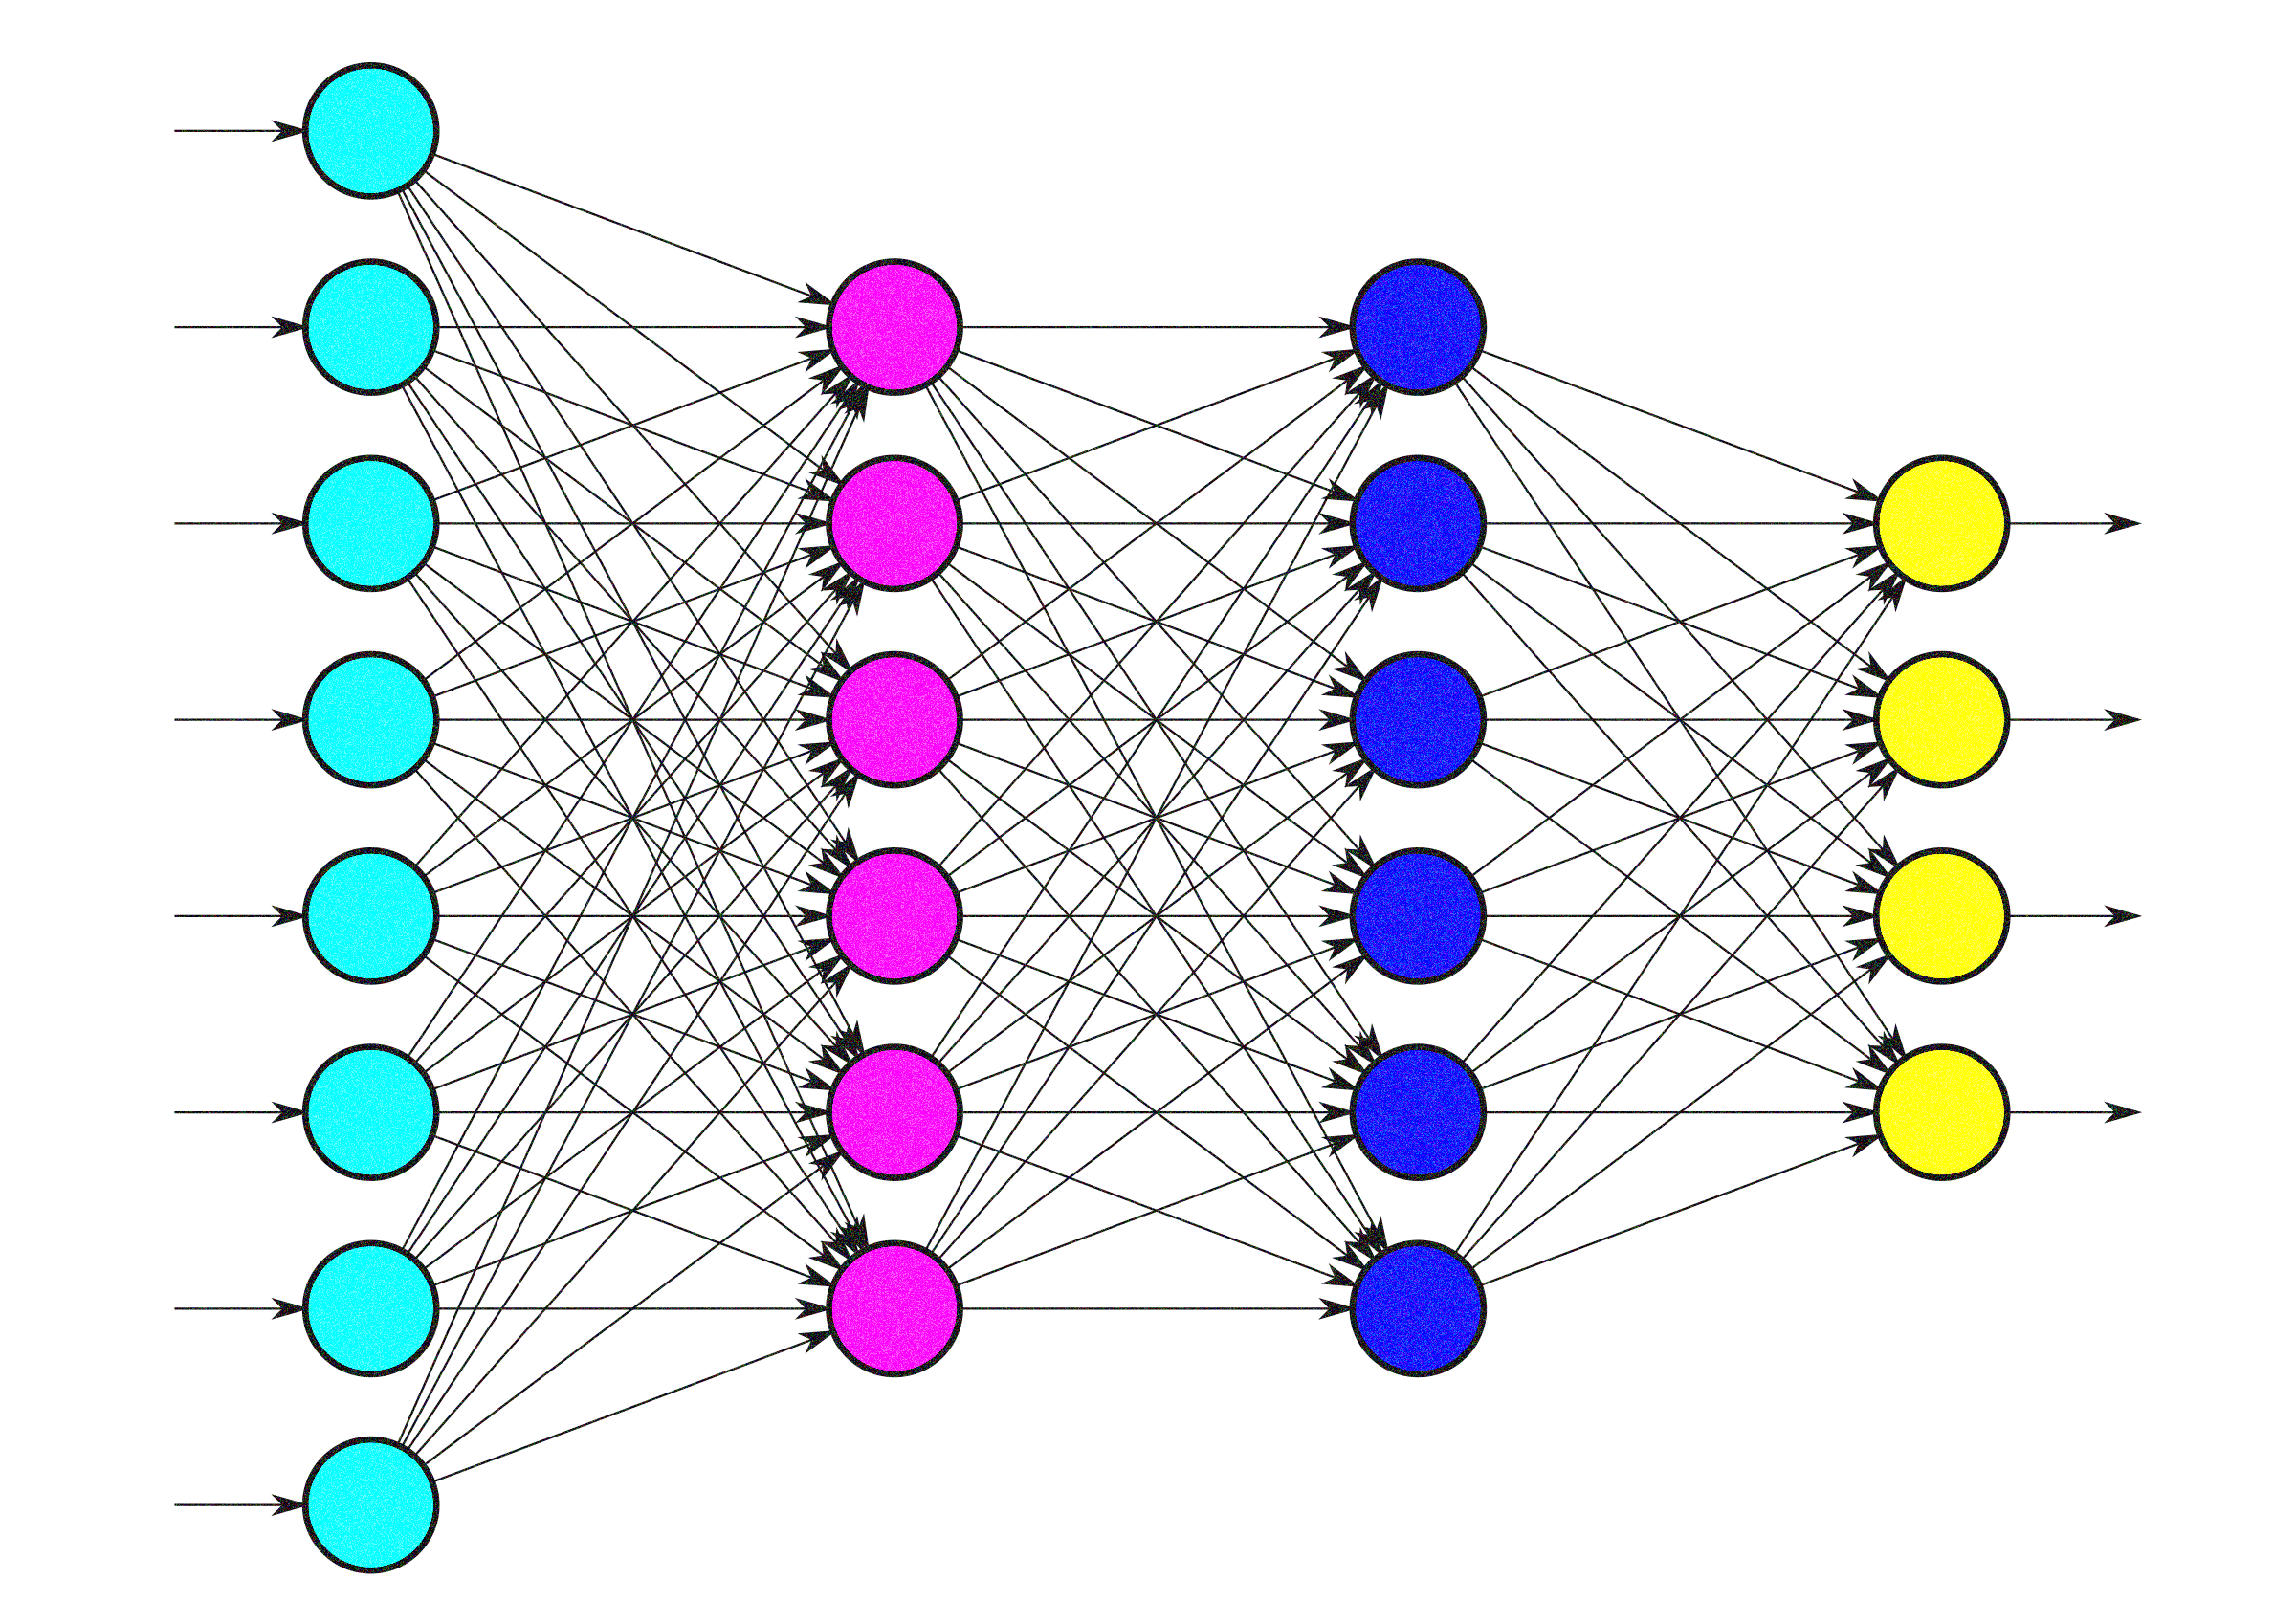
The System
What we see is only a perception. What we read is only an opinion. -Anonymous
The system proposes an automated segmentation method that relies upon CNN, determining 3 x 3 kernels. It proposes a novel detection technique on the basis of high-level extracted features from CNNs making use of Hough transform technique.
The processes involved in the proposed approach being: Data collection, Pre-processing, Average filtering, the segmentation process for pixel based detection, segmentation and feature extraction and finally the classification.
BRAIN TUMOR DETECTION USING MACHINE LEARNING APPROACH
03

Slide 4

Literature Survey – Part 1
C. Hemasundara Rao et.al, suggests an automated method for detection and segmenting affected areas. Proposed method suggests: initial segmentation, Modelling and Optimizing the energy function.
Atiq Islam et.al suggests using the multi-fractal feature extraction and AdaBoost classification schemes for detection and segmentation.
Meiyan Huang et.al suggests using the local independent projection-based classification for classifying voxel and extracting path feature..
Bjoern H. Menze et.al, presents multimodal tumor segmentation Various segmentation algorithm are being combined to gain better performance.
Shamsul Huda et.al presents hybrid feature selection using ensemble classification for performing tumor diagnosis.
Sergio Pereira et.al presents automated
methods for identification/type cataloging by using MRI of right from
when one could do a scan in the computer system.
BRAIN TUMOR DETECTION USING MACHINE LEARNING APPROACH
04

Slide 5

Literature Survey – Part 2
J. Seetha et.al, suggests use of MRI images for the diagnosis. The scan usually produces huge data which makes the manual classification process slow.
N.V. Shree et.al, targets on noise removal, extraction
of matrix features, tumor region growing segmentation for
minimizing complexity and enhanced performance.
Z. Tang et.al, presents MA segmentation for MRI of Brain. It basically works by registering and fusing label information from atlases into a new brain image for the process of segmentation.
B. Singh et.al, suggests pre-processing where there is noise elimination by
employing fuzzy filter and mean shift based fuzzy c-means algorithm which requires low computation and offers better output..
Garima Singh et.al, presents a technique to classify and analyze with de-noising filters like the Adaptive filter, Median filter, Un-sharp masking filter, Averaging filter and Gaussian filter.
G. Rajesh Chandra et.al, suggests soft thresholding DWT for improvisation and genetic algorithms for the purpose of segmentation.
BRAIN TUMOR DETECTION USING MACHINE LEARNING APPROACH
05

Slide 6
System Architecture
Brain tumor basically symbolizes abnormal and uncontrollable growth of cells within the brain. Basically it’s of two types: malignant tumor and benign tumors.
Convolution Neural Networks consists of multiple layers of responsive fields. The technique of Brain tumor segmentation is based on CNN by determining small 3 x 3 kernels.
Utilization of small kernels allows for an in-depth architecture, apart from posing a positive impact in contrast to over-fitting, with minimum type of masses existing in the network.
At the same time inspecting the employment of intensity normalization as a preprocessing process.
It’s imbibed in combination with information segmentation, being intolerable against neoplasm segmentation concerning the MR imaging picture.
BRAIN TUMOR DETECTION USING MACHINE LEARNING APPROACH
06

Slide 7

Brain Image Processing
Due to the noise in Magnetic Resonance, images get affected. For noise reduction, system proposes local smoothing methods & nonlocal means.
Pre-processing involves steps like data cleaning, data transformation, data integration, data resizing, data reduction etc
The image pre-processing eliminates unnecessary data and smooth up noise, detect and eliminate the outlier and rectify the inconsistencies.
Lastly, normalization and aggregation is performed.
The technique of Image-processing proves to be highly significant in determining particular image, removing noise and for improvising the quality.
BRAIN TUMOR DETECTION USING MACHINE LEARNING APPROACH
07

Slide 8

Average Filtering
The normal channel being the convolution work that is utilized to set the clamor in the images.
The Preprocessing step abandons the disturbances but still after applying it the image doesn’t hold suitable for future process.
Therefore, the Average channel resolves this issue by providing acceptable and smooth picture.
The Average channel resembles a non-linear channel unlike straight channels.
It replace the pixel esteems with an Average esteem that
being nearly accessible.
Moreover, Average channel tends to be edge safeguarding.
It helps in abandoning salt and pepper disorder in the images.
BRAIN TUMOR DETECTION USING MACHINE LEARNING APPROACH
08

Slide 9
Average Filtering
Algorithm
Output
The current pixel is replaced with the normal esteem.
Determine the normal of the vector.
Step 6
Step 5
Perform pixel sorting in expanding request and save it to a vector.
Choose a 3X3 window near the current pixel within the picture.
Step 4
The picture is provided as input.
Step 3
Repeat Steps 2 to 5 till we process the entire image.
Step 2
Step 1
BRAIN TUMOR DETECTION USING MACHINE LEARNING APPROACH
09

Slide 10

Pixel based Segmentation
Image Segmentation is a common technique of digital image processing.
Lately, Brain tumor image sectioning in MRI has spurred up as a popular research in the domain of medical imaging system.
The process of Segmentation helps a lot to simplify the detection of malignant and benign tumors.
BRAIN TUMOR DETECTION USING MACHINE LEARNING APPROACH
10

Slide 11
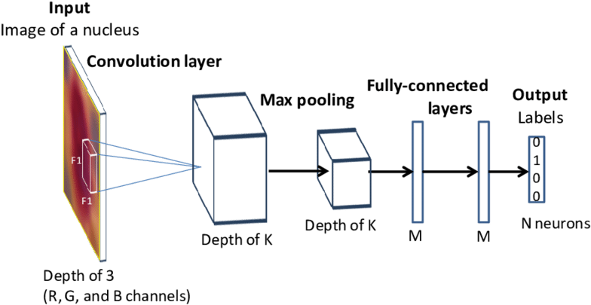
Convolutional Neural Networks
Convolutional Neural Network is employed for segmenting the images. It directly extracts features from pixels with least preprocessing involved.
It contains encoder and decoder blocks which basically manage to split the image and re-build again before it’s forwarded via few final convolutional layers.
CNN is a significant approach of deep learning which is being employed in image recognition.
Convolution and pooling layers are arranged till high level of classification accuracy is achieved. Moreover, few feature maps are identified in every convolutional layer and weights linked to it are being shared.
CNN possess less specific tasks in contrast to the conventional methods and helps in thoroughly extracting features.
BRAIN TUMOR DETECTION USING MACHINE LEARNING APPROACH
11

Slide 12
Convolutional Neural Networks
Algorithm
At time of training, loss layer is appended in the end to provide a feedback to
neural network
The neurons in proceeding layer is associated with each neuron in the next layer.
Step 6
Training period is being fastened by employing RELU (rectified linear unit).
The Activation layer controls the signal transfer from one layer to other layer.
Step 5
The filter sensitivity is minimized by smoothing the conv filter (by sub-sampling).
Step 4
Convolution filter is applied in the first layer
Step 3
Step 2
Step 1
BRAIN TUMOR DETECTION USING MACHINE LEARNING APPROACH
12

Slide 13
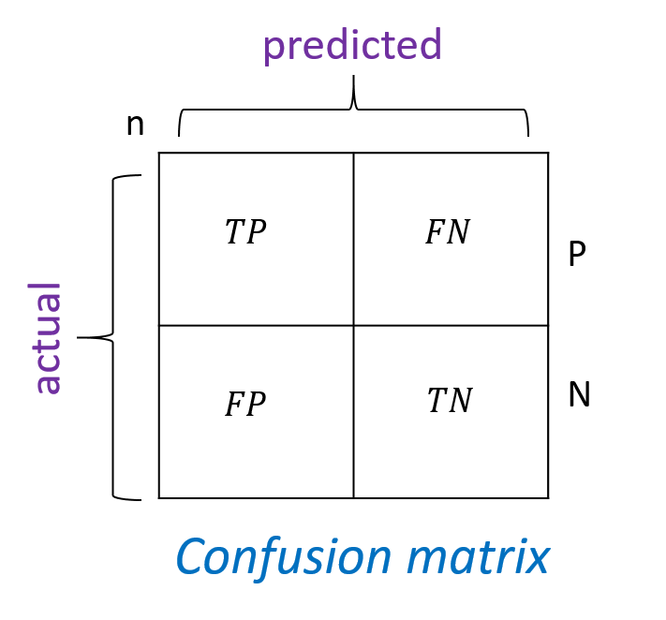
Evaluation Metrics
The proposed CNNs performance is assessed with Root Mean Square Error, recall, sensitivity, precision, F-score specificity, probability of the misclassification error and accuracy of the training and testing set.
Confusion Matrix is a good parameter to evaluate the performance of any model instead of plain accuracy as plain accuracy is easy to achieve in skewed sets.
Confusion Matrix has the following parameters: True Positive (TP), False Positive (FP), True Negative (TN) and False Negative (FN).
BRAIN TUMOR DETECTION USING MACHINE LEARNING APPROACH
13

Slide 14

Results and Discussion
The proposed method employs a mean field term within standard CNN objective function.
The technique is developed and applied in MATLAB environment by utilizing the image processing tool.
Datasets are assembled from the UCI datasets.
A comparison is found among all the features and the entire result being depicted in the figures.
The accuracy is computed which is then compared with rest of the methods.
Efficiency and training accuracy of the proposed brain tumor classification approach is computed.
BRAIN TUMOR DETECTION USING MACHINE LEARNING APPROACH
14

Slide 15

Results and Discussion
Tables and Analysis
ANALYSIS
Comparison of Various Algorithms
Table illustrates the comparison of various classification techniques
Techniques | Accuracy (%) | Efficiency (%)
Conditional Random Field | 89 % | 87.5%
Support Vector Machine | 84.5 % | 90.3 %
Genetic Algorithm | 83.64 % | 84.78 %
Convolutional Neural Network | 91 % | 92.7 %
It represents overall performance and comparison output in contrast to various prevailing techniques such as CRF, SVM and GA. The proposed CNN (Convolutional Neural Network) yields in improvised output in contrast to the existing algorithms.
BRAIN TUMOR DETECTION USING MACHINE LEARNING APPROACH
15

Slide 16
Simulation Results
The datasets are accumulated from online datasets and the MATLAB environment is used for the development process.
Figures presented below depicts the overall images of brain tumor detection.
Input image undergoes pre-processing.
Thereafter the pre-processed image is enhanced and the image is extracted.
Eventually, the brain tumor classified image is retrieved and implemented successfully.
BRAIN TUMOR DETECTION USING MACHINE LEARNING APPROACH
16

Slide 17

Conclusion
Referring the earlier section, it is revealed that output generated is quite accurate. Accuracy achieved at the end relies upon each step and processing done in it. There are lot of existing methods for every step, hence the methods that give optimum results are selected.
At the last, Brain Tumor Classification takes place. To detect Brain Tumor Detection there exist different standard approaches but the present work utilizes the traditional Neural Network approach for detecting the brain tumor, since the brain tumor detection images relies upon the neighborhood pixels.
The CNN approach discussed provides powerful brain tumor detection. The proposed algorithm is implemented on multiple images present in the dataset and the output retrieved is best and effective.
BRAIN TUMOR DETECTION USING MACHINE LEARNING APPROACH
17

Slide 18
References
A Tree is nothing without it’s roots
S. Pereira, “Brain tumor segmentation using convolutional neural networks in MRI
images,” IEEE Transactions on Medical Imaging, 2016.
M. S. Ali Isina, C Direkoglu, “Review of MRI based brain tumor image segmentation
using deep learning methods,” Procedia Computer Science, vol. 102, pp. 317– 324, 2016.
J. Seetha and S. S. Raja, “Brain tumor classification using convolutional neural networks,” Biomedical & Pharmacology Journal, vol. 11, pp. 1457–1461, 2018.
P. S. Nelly Gordillo, Eduard Montseny, “State of the art survey on MRI brain tumor
segmentation,” Magnetic Resonance Imaging, vol. 31, pp. 1426–1438, 2013
B. Singh and P. Aggarwal, “Detection of brain tumor using modified mean-shift based fuzzy c-mean segmentation from MRI images,” IEEE, pp. 536–545, 2017.
A. F. Muda, N. M. Saad, S. A. R. A. Bakar, S. Muda, and A. A. R., “Brain lesion
segmentation using fuzzy c-means on diffusion-weighted imaging,,” ARP Journal of Engineering and Applied Sciences, vol. 10, no. 3, pp. 1426–1438, 2015.
N. V. Shree and T. N. R. Kumar, “Identification and classification of brain tumor MRI
images with feature extraction using dwt and probabilistic neural network,” Springer, Brain Informatics, pp. 23–30.
C. Rao, P. Naganjaneyulu, & K. Prasad, “Brain tumor detection and segmentation
using conditional random field,” in IEEE 7th International Advance Computing Conference, pp. 807–810, 2017.
Z. Tang, A. Sahar, Y. Pew-Thian, and S. Dinggang, “Multi-atlas segmentation of MR
tumor brain images using low-rank based image recovery,” IEEE Trans Med Imaging, vol. 37, no. 10, pp. 2224–2235, 2018.
A. Islam, “Multi-fractal texture estimation for detection and segmentation of brain
tumors,” IEEE, 2013.
G. Singh and D. M. Ansari, “Efficient detection of brain tumor from MRIs using k-means segmentation and normalized histogram,” IEEE, 2016.
M. Huang, “Brain tumor segmentation based on local independent projection based classification,” IEEE Transactions on Biomedical Engineering, 2013.
G. R. Chandra and D. K. R. H. Rao, “Tumor detection in brain using genetic algorithm,” in Elsevier, 7th International Conference on Communication, Computing and Virtualization, pp. 449–457, 2016.
B. H. Menze, “The multimodal brain tumor image segmentation benchmark (brats)”, IEEE Transactions on Medical Imaging, 2014.
S. Huda, “A hybrid feature selection with ensemble classification for imbalanced
healthcare data: A case study for brain tumor diagnosis,” IEEE Access, vol. 4, 2017.
BRAIN TUMOR DETECTION USING MACHINE LEARNING APPROACH
18

